Slide 1
Assessment
Eleni O’Connor MSN, BS, RN
Assessment Chair
Associate Professor of Nursing
Northwestern College

Slide 2
Objectives
Introduction​- What is Assessment?
Assessment Language
Program Goals
​Curriculum Maps & Assessment Plans
Communicating Assessment​

Slide 3
What is Assessment?
Assessment is the systematic collection, review and use of information about educational programs to improve student learning. Assessment focuses on what students know, what they can do, and if intended learning outcomes are being met when they graduate.
Why is assessment important?
For evaluation of program effectiveness!
To identify students' strengths and weaknesses and the gaps they may have in their learning/skills.
To assist in setting targets for students, instructors, and subject specializations.
To review and monitor teaching and learning strategies and process.

Slide 4
Assessment language
Common Terminology
Terminology | Definition | Abbreviation (if applicable)
Program Goal | Specific knowledge, skills, and values expected of graduates and should be consistent with the mission of the program and the mission of the institution.
Intended Learning Outcome *specific to each Program Goal | define what a learner will have acquired and will be able to do upon successfully completing their studies. | ILO
Curriculum Map | Shows where within a curriculum student learning outcomes are taught and assessed. | I-Introduced R-Reinforced A-Assessed *-Rubric Used
Diagnostic Assessment | Establishing student baseline knowledge before instruction. | DA
Formative Assessment | Evaluating student comprehension of content while instruction is ongoing. | FA
Summative Assessment | Evaluation of student learning at the end of an instructional unit by comparing it against program standard or benchmark. | SA

Slide 5
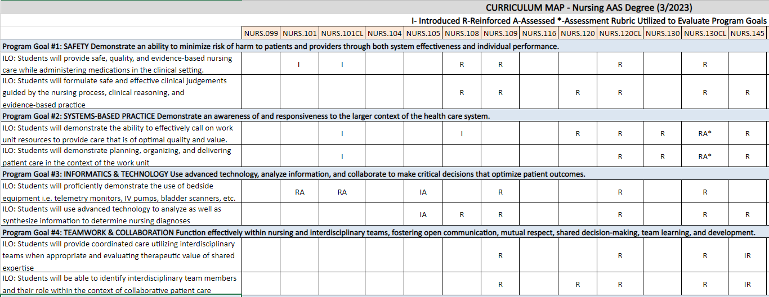
Curriculum map example

Slide 6
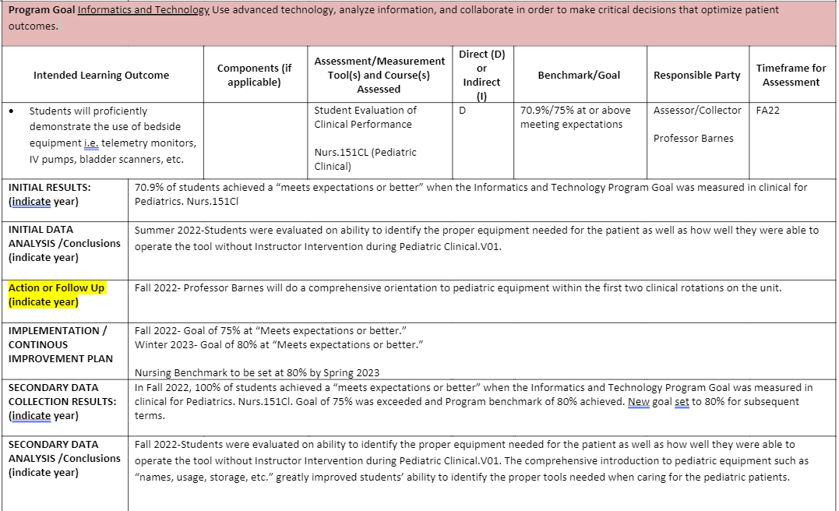
Assessment Plan example

Slide 7
Now you know…so how can you speak to assessment culture at nc?
Generate a casual rhetoric
How often do we assess?
“Assessment culture at NC helps us determine if our students are meeting our program goal benchmarks.”
“We use assessments to measure student strengths and weaknesses to adjust instruction for best student outcomes.”
“Some assessment tools we use in the classroom are surveys, quizzes, in-class case studies, and mastery exams to gather data for program goal progress.”
Assessment for student learning is ongoing, but formal assessment rubrics used to evaluate progress toward meeting program goal standards is dependent on each program.
Initial data will be collected for at least 2-4 cycles dependent on program.
We will use this data to create an action plan to meet and exceed our established benchmarks.
Once benchmarks have been met, our assessment rubrics can be used as auditing tools to promote consistency and excellence within our programs.

Slide 8
Examples you use everyday…
Diagnostic assessments
Formative assessments
Summative assessments
Introductions-student surveys
TEAS Exam
“Tell me what you know…”
Practice questions in class
Discussion Boards
Rough Drafts
Open Forums for content discussion
Unit Exams
Final Exams
Mastery Exams
Clinical Skill Day (w/o instruction)

Slide 9
SUMMARY
Assessment measures if and how students are learning and if the teaching methods are effectively relaying the intended messages. Hanna and Dettmer (2004) suggest that you should strive to develop a range of assessments strategies that match all aspects of their instructional plans. The selection of appropriate assessments should also match course and program objectives necessary for program-specific accreditation requirements.

Slide 10
THANK YOU
Eleni O’Connor MSN, BS, RN
eoconnor@nc.edu

Slide 11
References
Hanna, G. S., & Dettmer, P. A. (2004). Assessment for effective teaching: Using context-adaptive planning. Boston, MA: Pearson A&B.
Just Science Now! (n.d.). Assessment-inquiry connection. https://www.justsciencenow.com/assessment/index.htm

